Slide 1
Detecting and assessing trends of CFCs and substitutes from IASI measurements
Hélène De Longueville¹, L. Clarisse¹, B. Franco¹, S. Whitburn¹, C. Clerbaux^{1,2}, C. Camy-Peyret³ and P.F. Coheur¹
Spectroscopy, Quantum Chemistry and Atmospheric Remote Sensing (SQUARES), Université libre de Bruxelles (ULB), Brussels, Belgium
LATMOS/IPSL, Sorbonne Université, UVSQ, CNRS, Paris, France
Institut Pierre-Simon Laplace (IPSL), UMPC/UVSQ, Paris, France

Slide 2
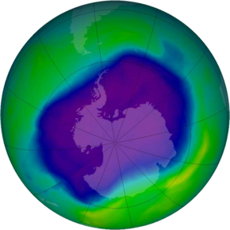
Introduction to halocarbons
$$O_{3}$$
1930
CFCs (Ozone Depleting Substances + GreenHouse Gases)
CFC-11 (CFCl₃)
CFC-12 (CF₂Cl₂)
HCFC-22 (CHF₂Cl) HFC-134a (CH₂FCF₃) …
1980
Ozone Hole
Montreal Protocol: 1987
CFCs
HCFCs (ODS + GHG)
1992
HCFCs
HFCs (GHG)
Kigali Amendment: 2016
HFCs

Slide 3
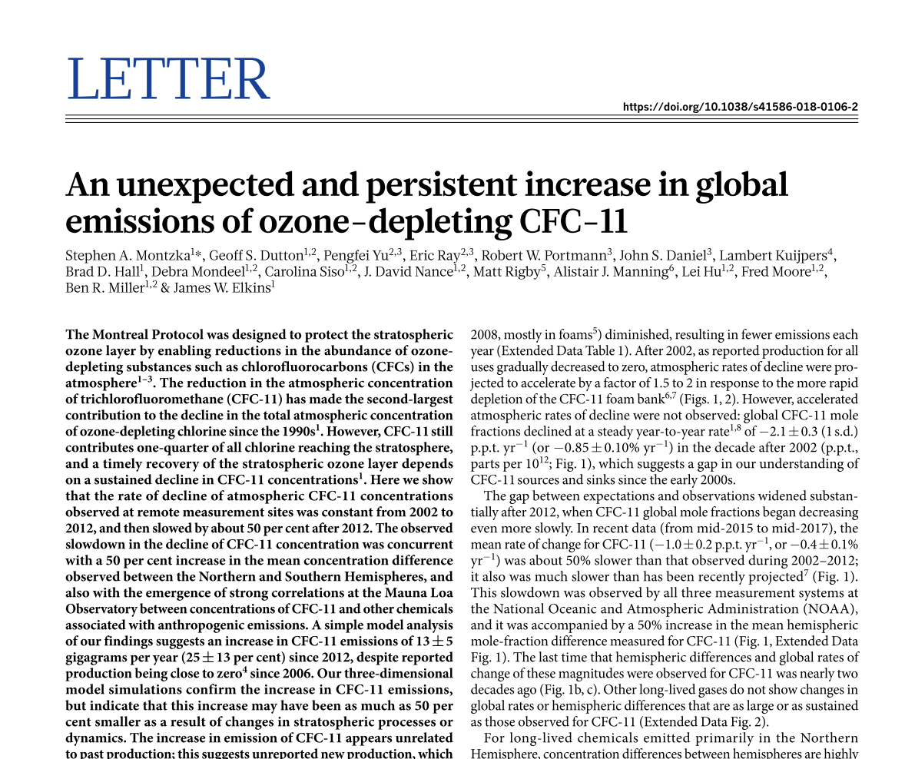
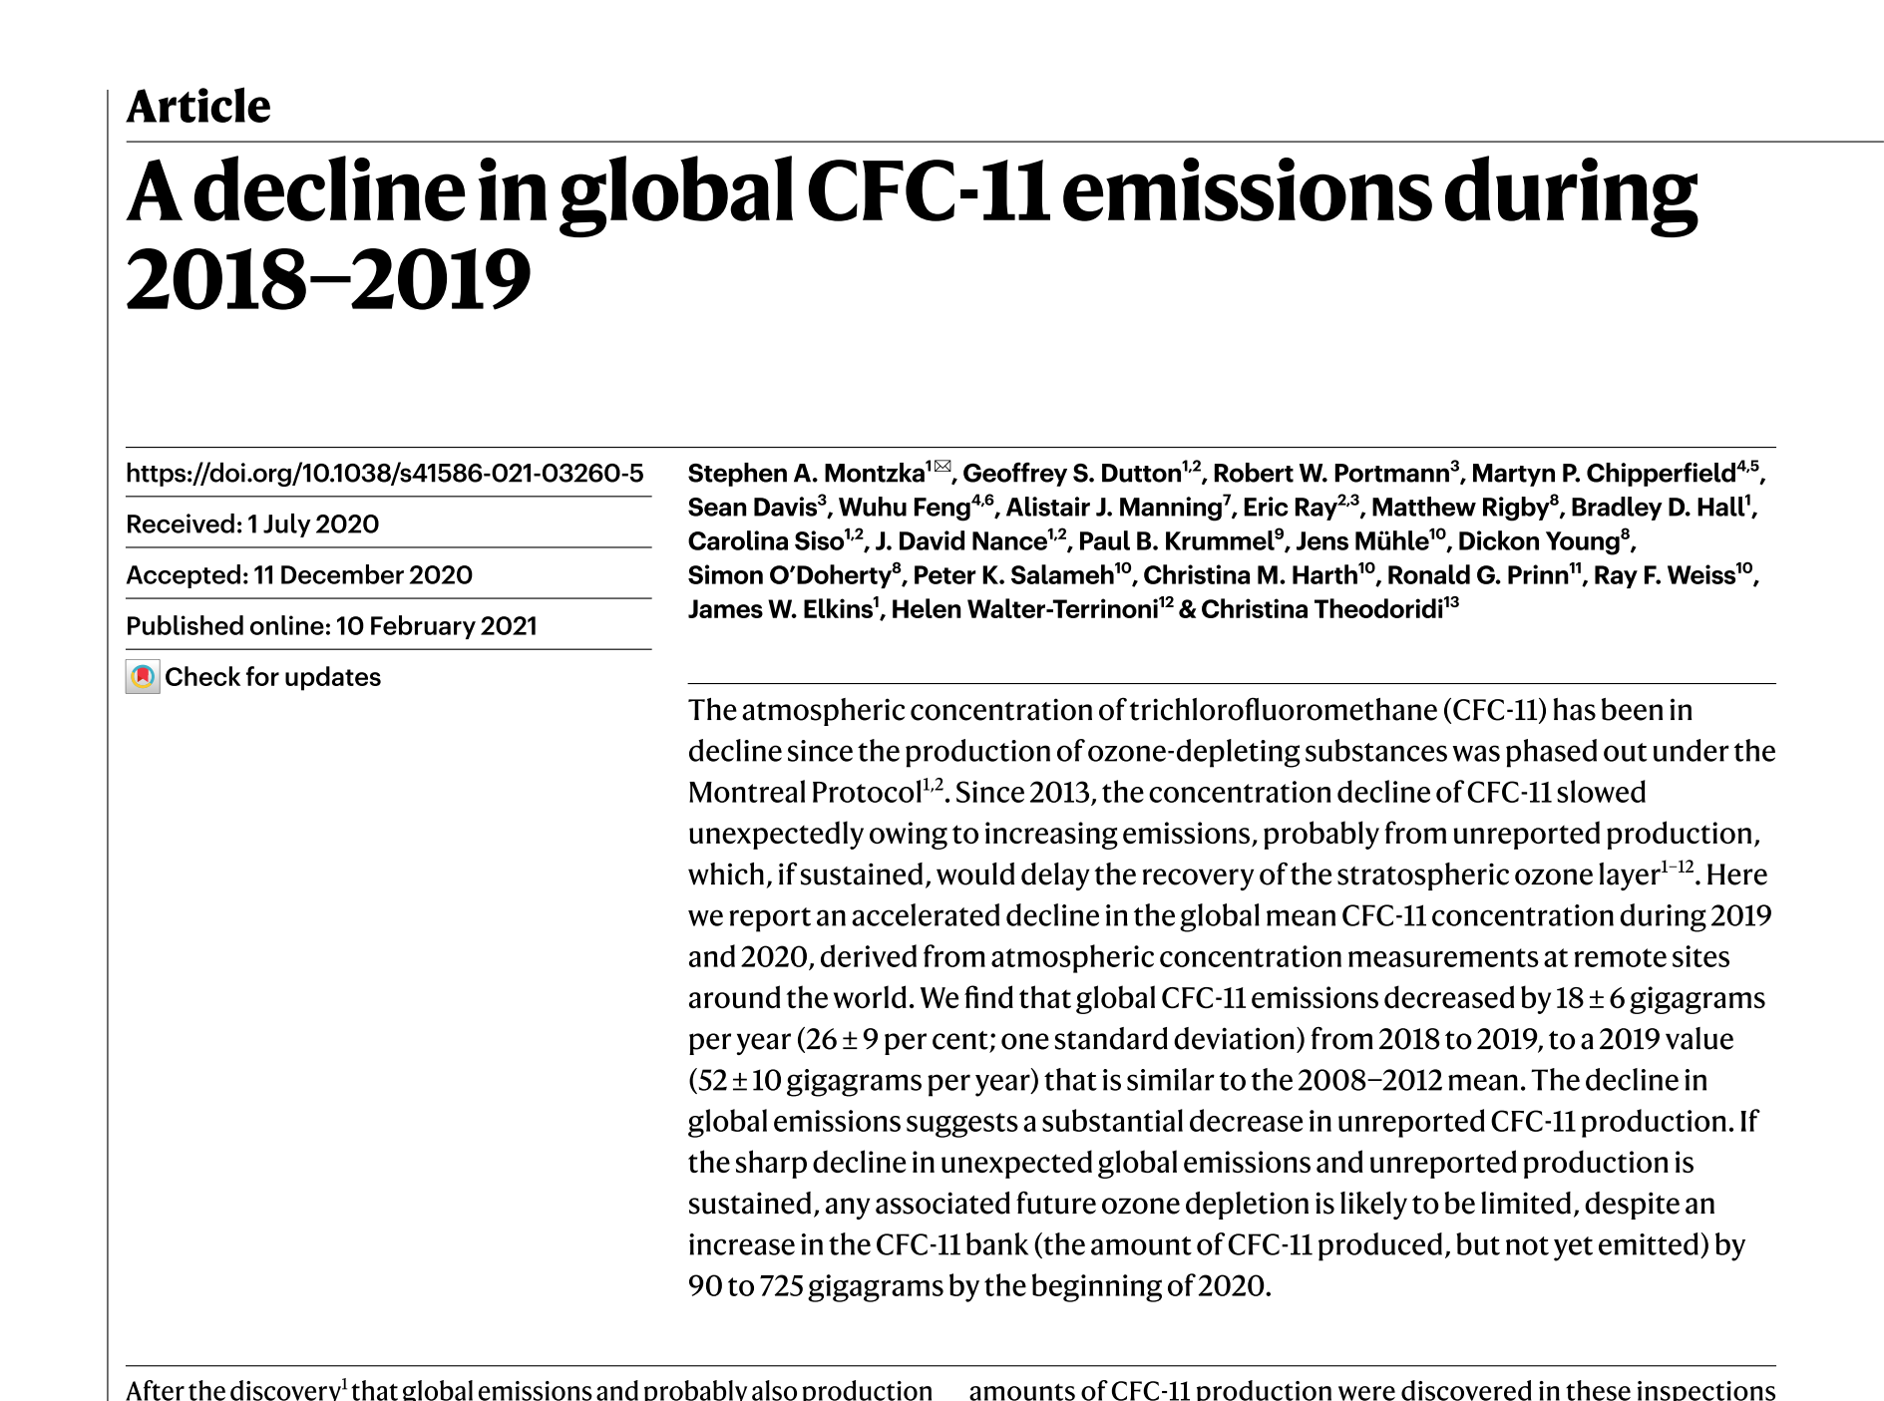
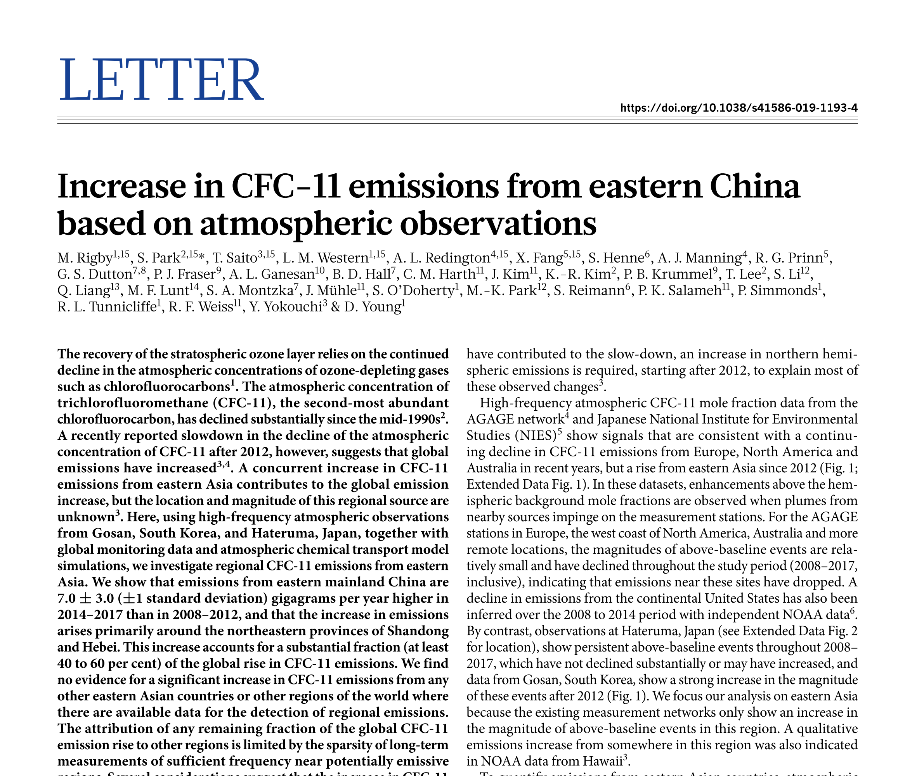
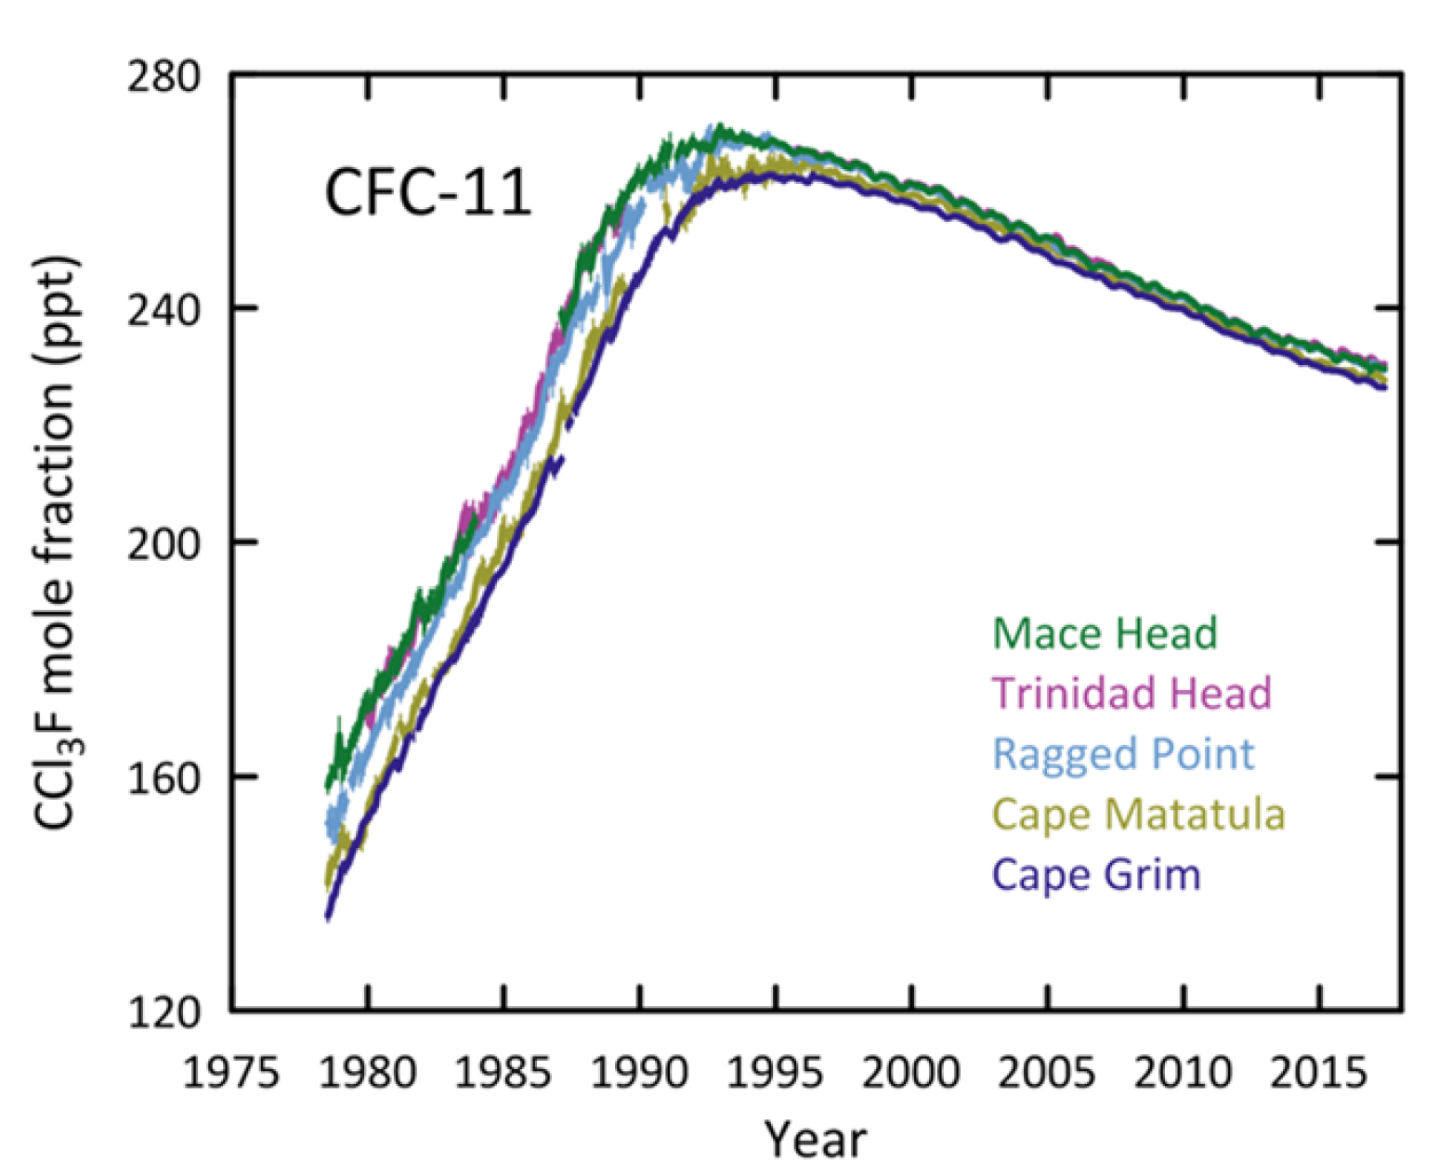
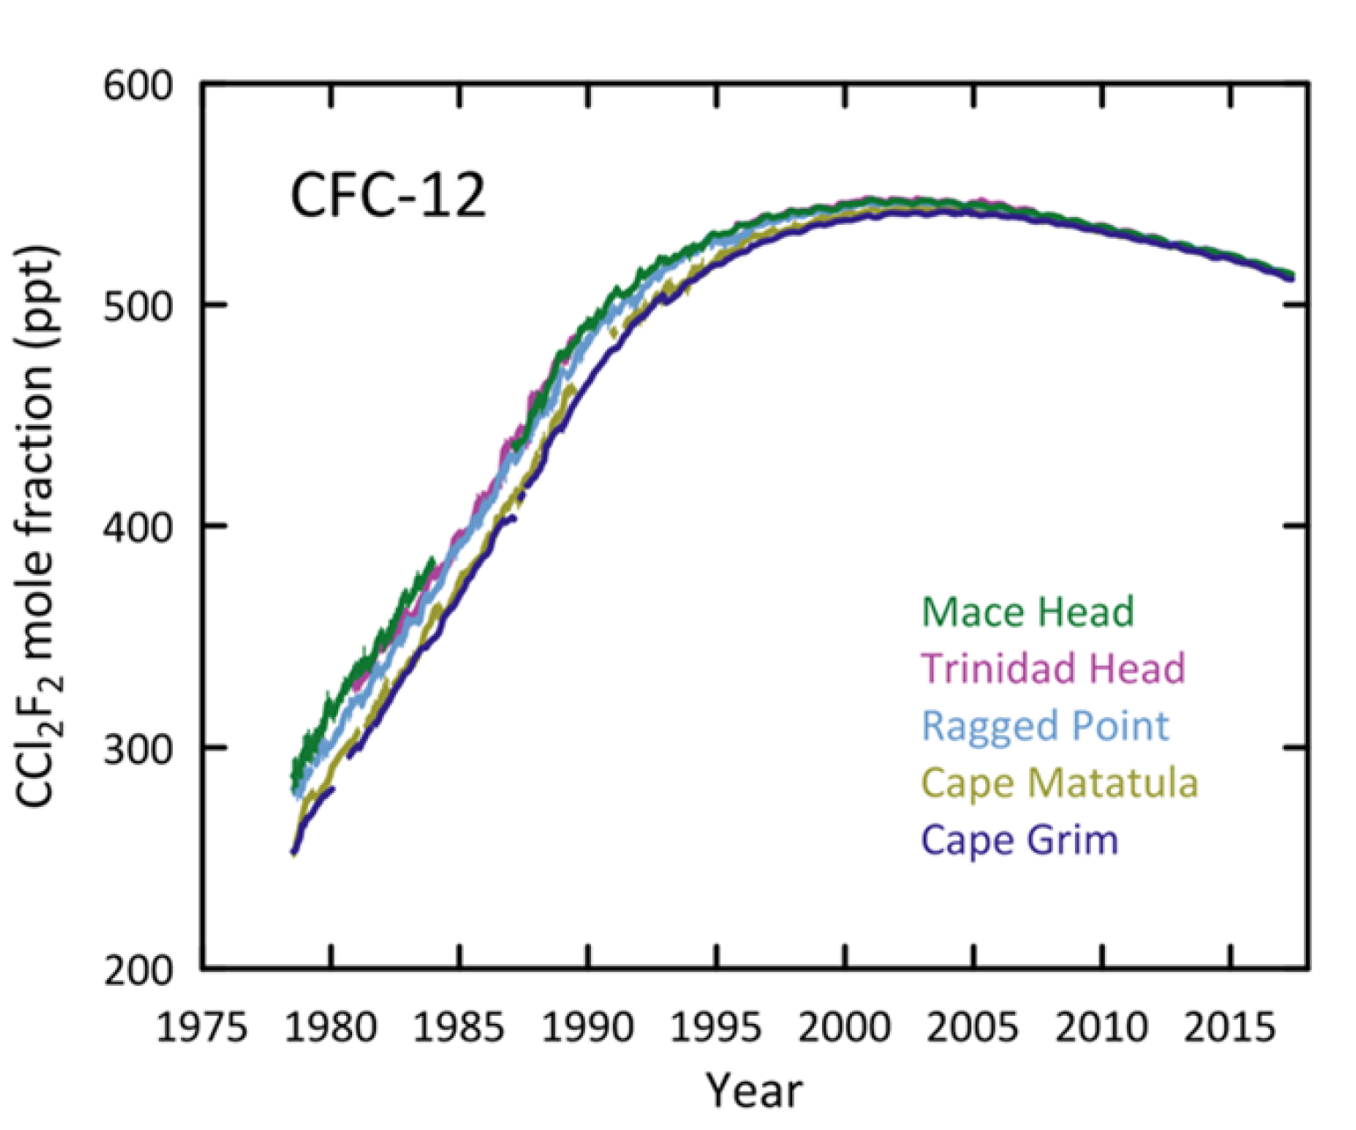
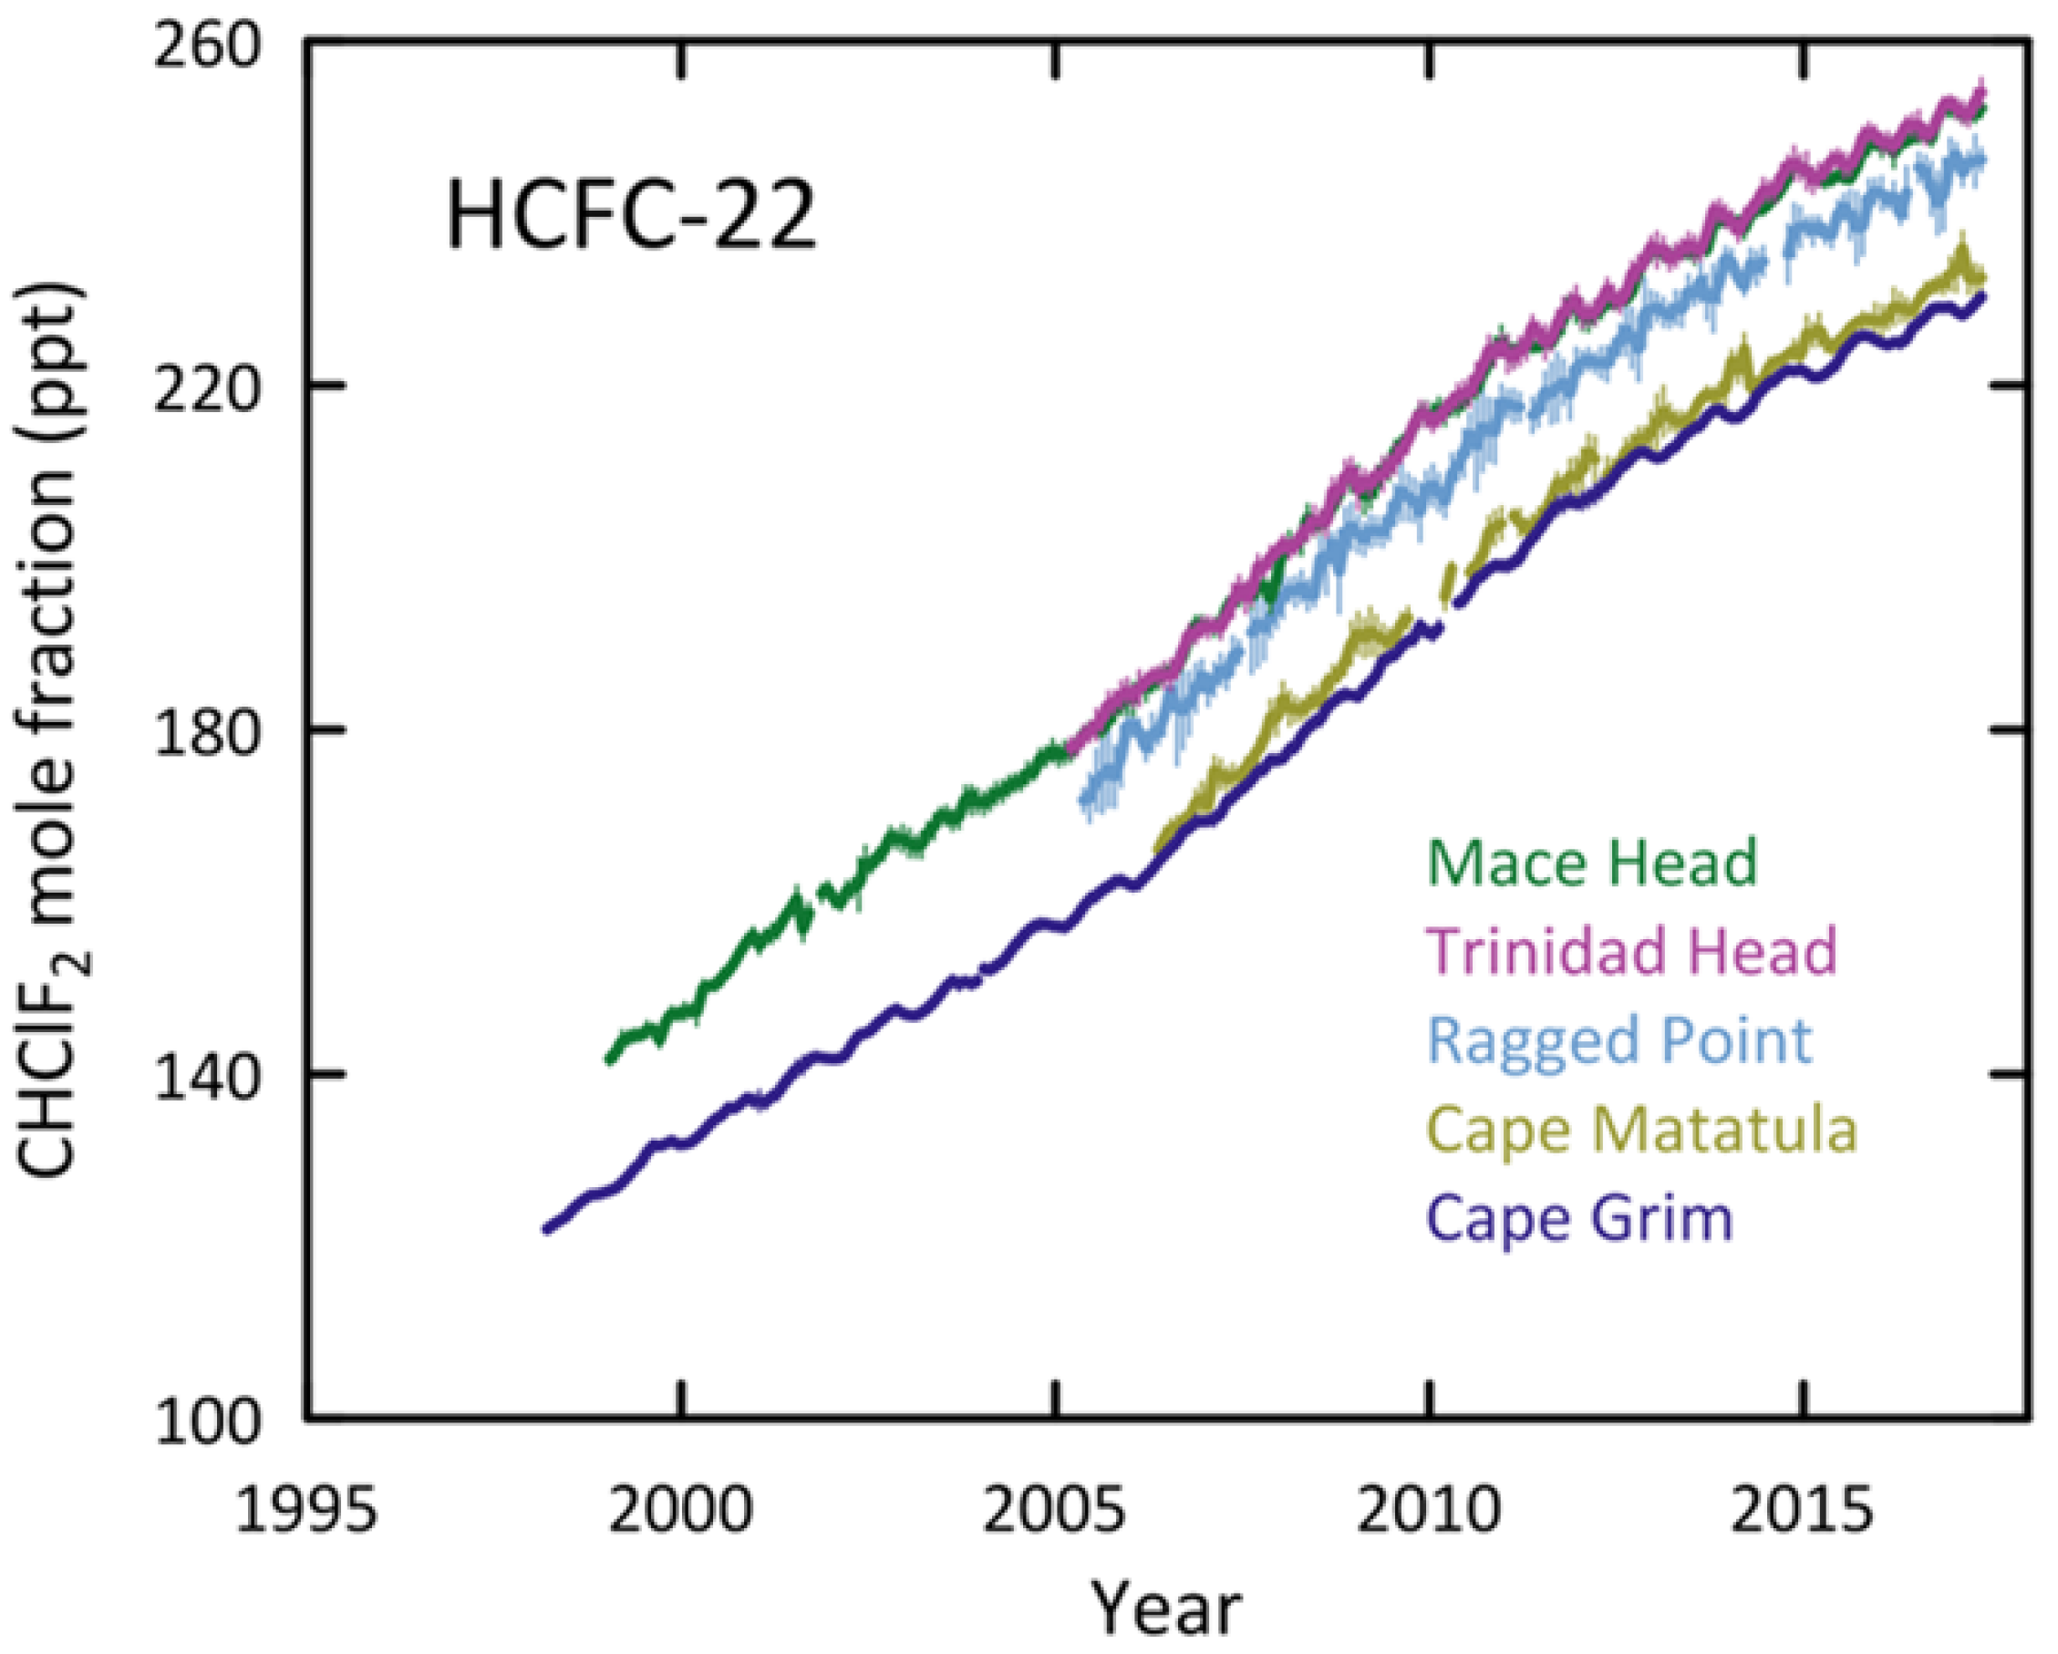
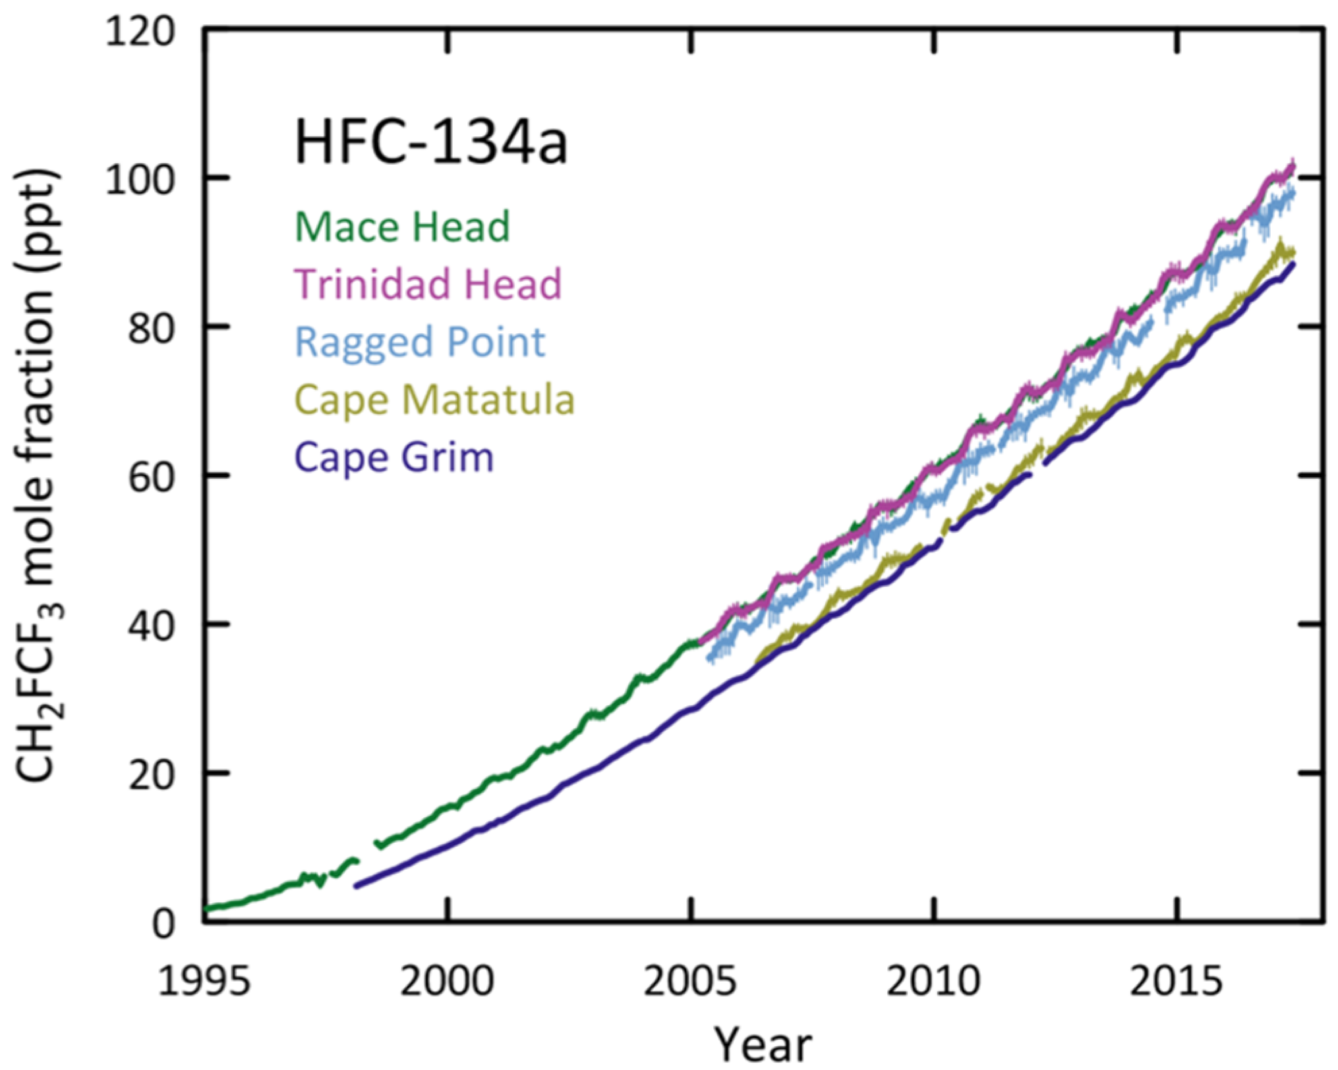
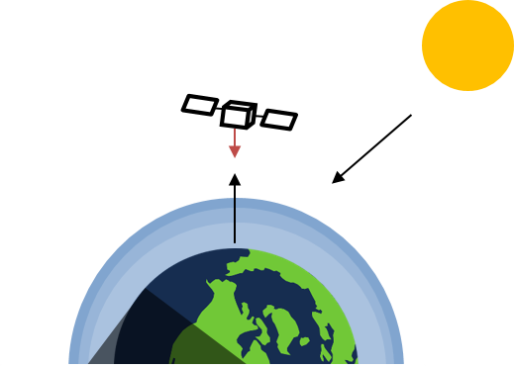
Introduction to halocarbons
Monitoring of atmospheric concentrations
In situ measurements: AGAGE
Remote sensing measurements:
ground
space
limb
nadir
CFC-11
CFC-12
HCFC-22
HFC-134a
nadir view

Slide 4
Purpose
Can nadir-pointing IR satellite sounders contribute to monitoring atmospheric concentrations of halocarbons ?
Detection of their spectral signatures
Retrieval of the time evolution of their concentration

Slide 5
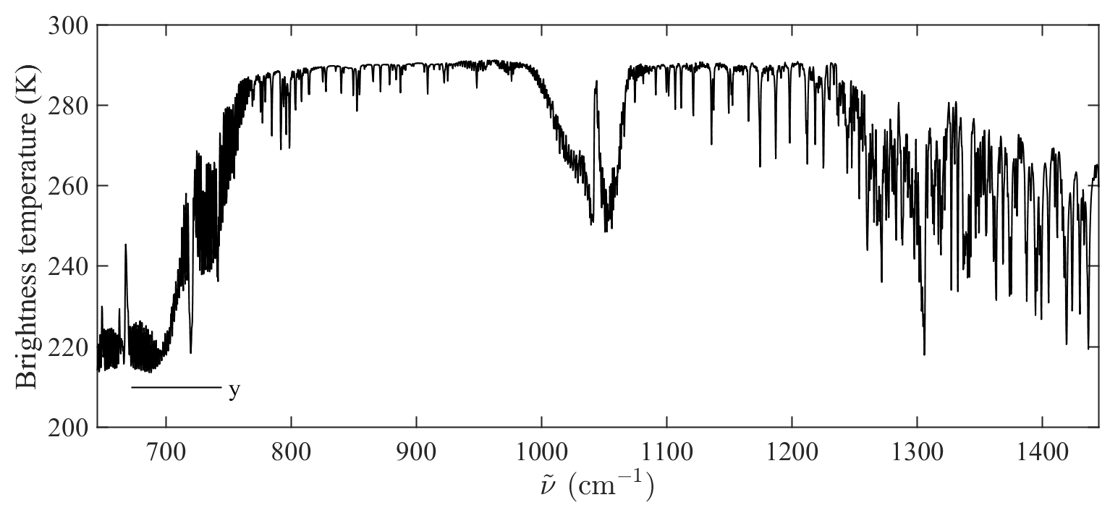
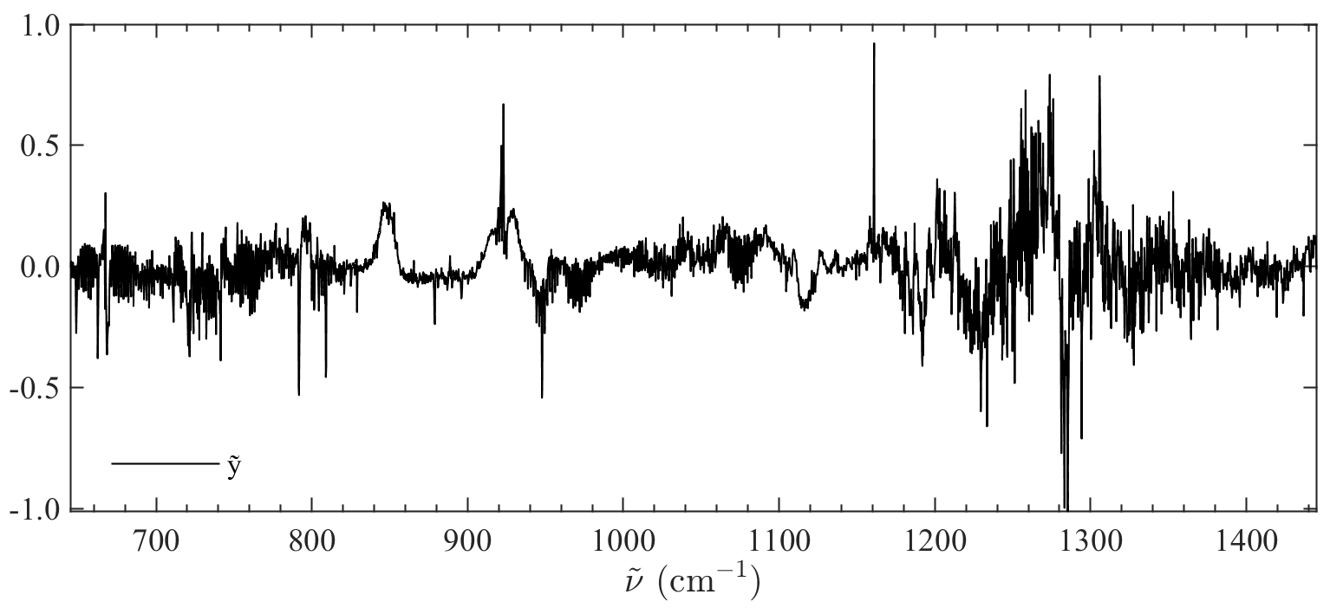
Development of a methodology for the detection of halocarbons
Whitening transformation
Whitening a spectrum produces another spectrum in which most of the background signal is removed and all spectral aberrations are exposed.
covariance matrix
reference mean spectrum
$$\overline{y}=\frac{\sum_{n=1}^{N}{y_{n}}}{N}$$
Background conditions:
T
ϵ
H₂O, CO₂, O₃, CH₄, N₂O
$$\tilde{y}=S^{− \frac{1}{2}} (y−\overline{y})$$
$$S=\frac{\sum_{n=1}^{N}{\left(y_{n}−\overline{y}\right){\left(y_{n}−\overline{y}\right)}^{T}}}{N−1}$$
whitened spectrum
spectrum
CO₂
N₂O
H₂O
CO₂
H₂O
whitening
O₃
CH₄

Slide 6
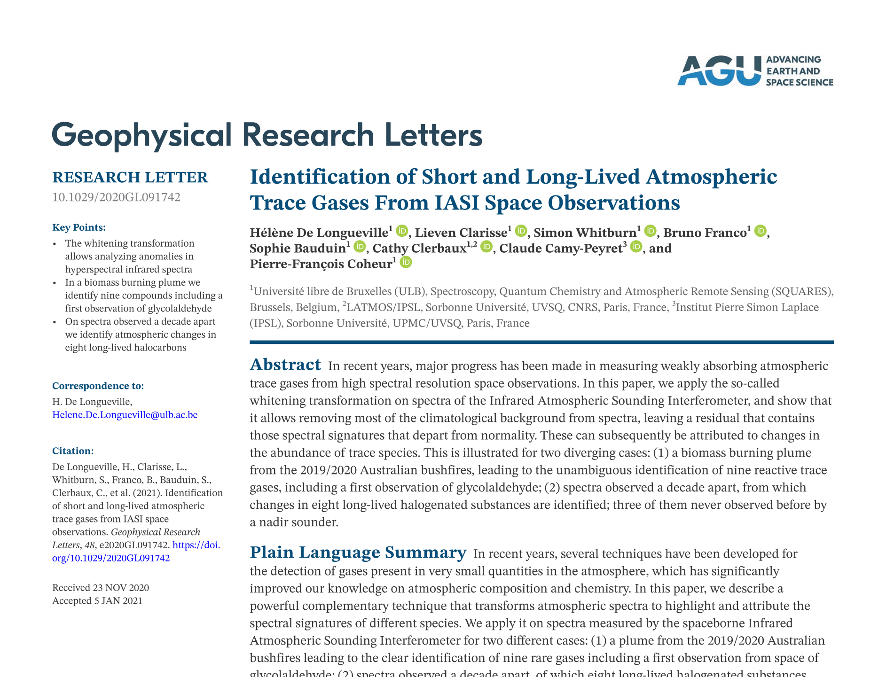
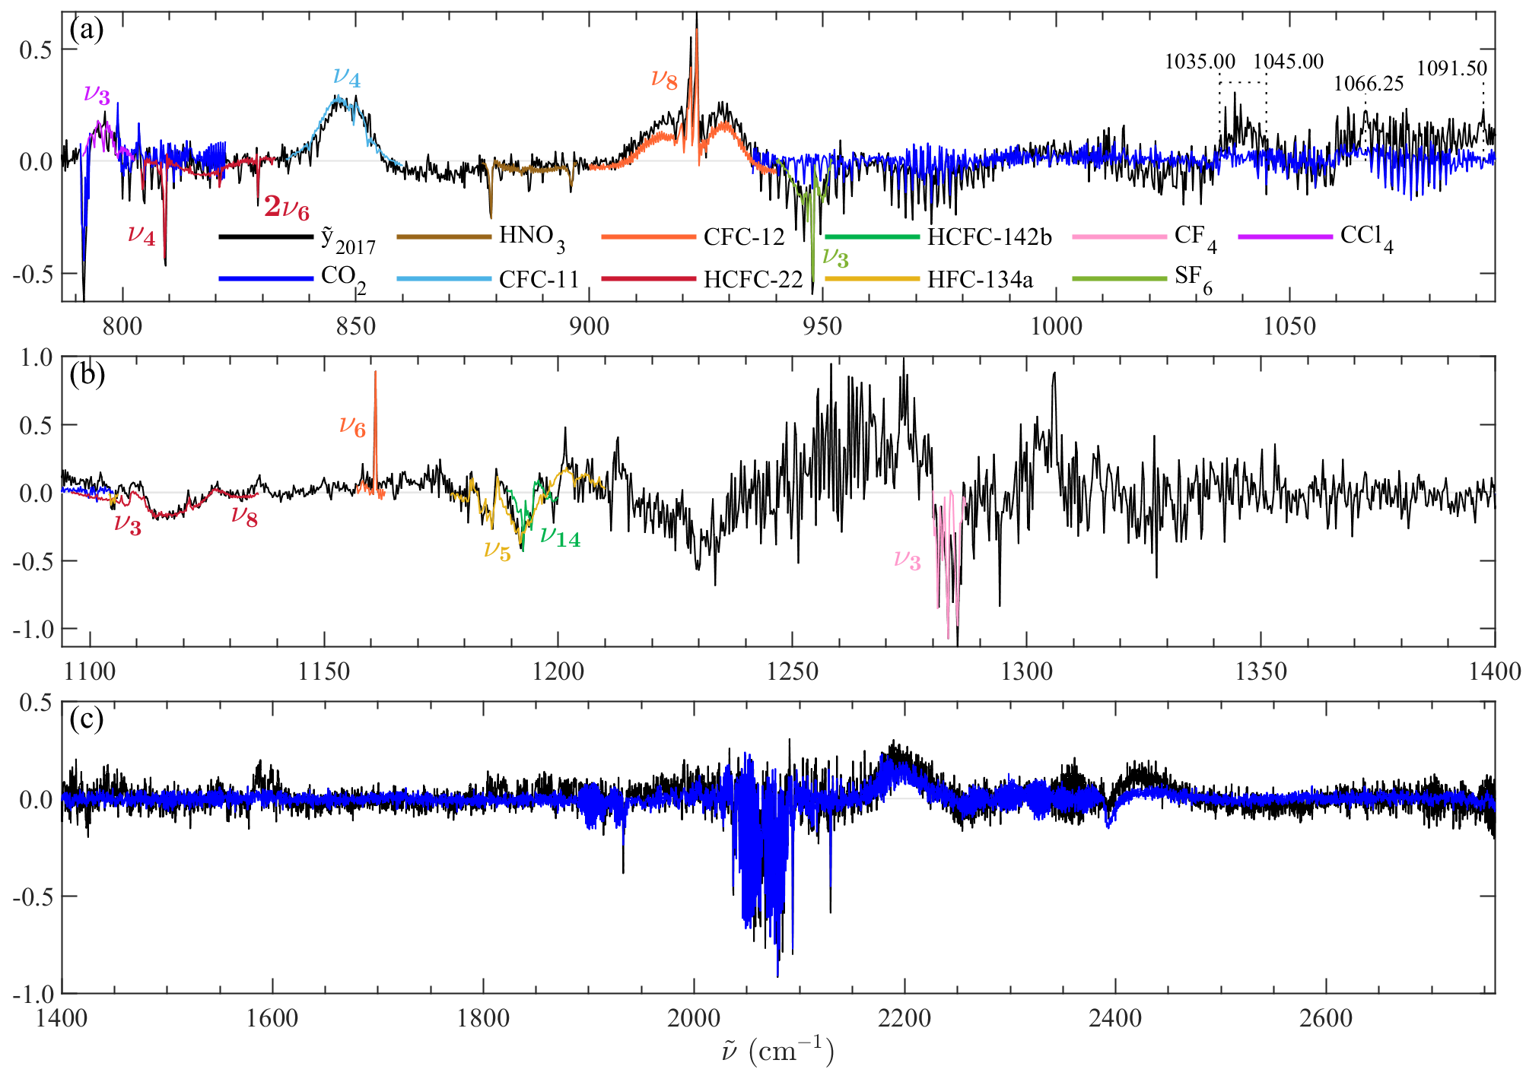
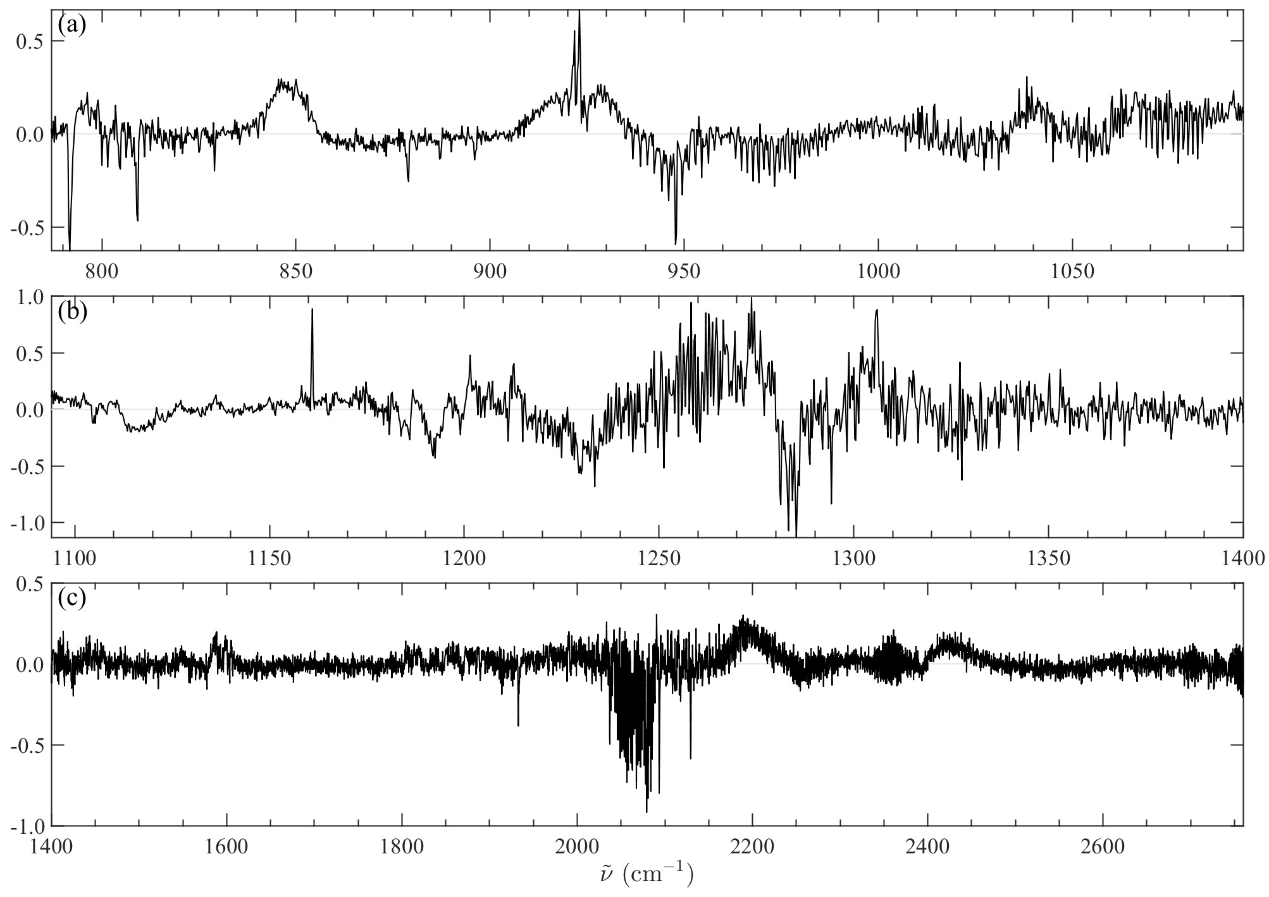
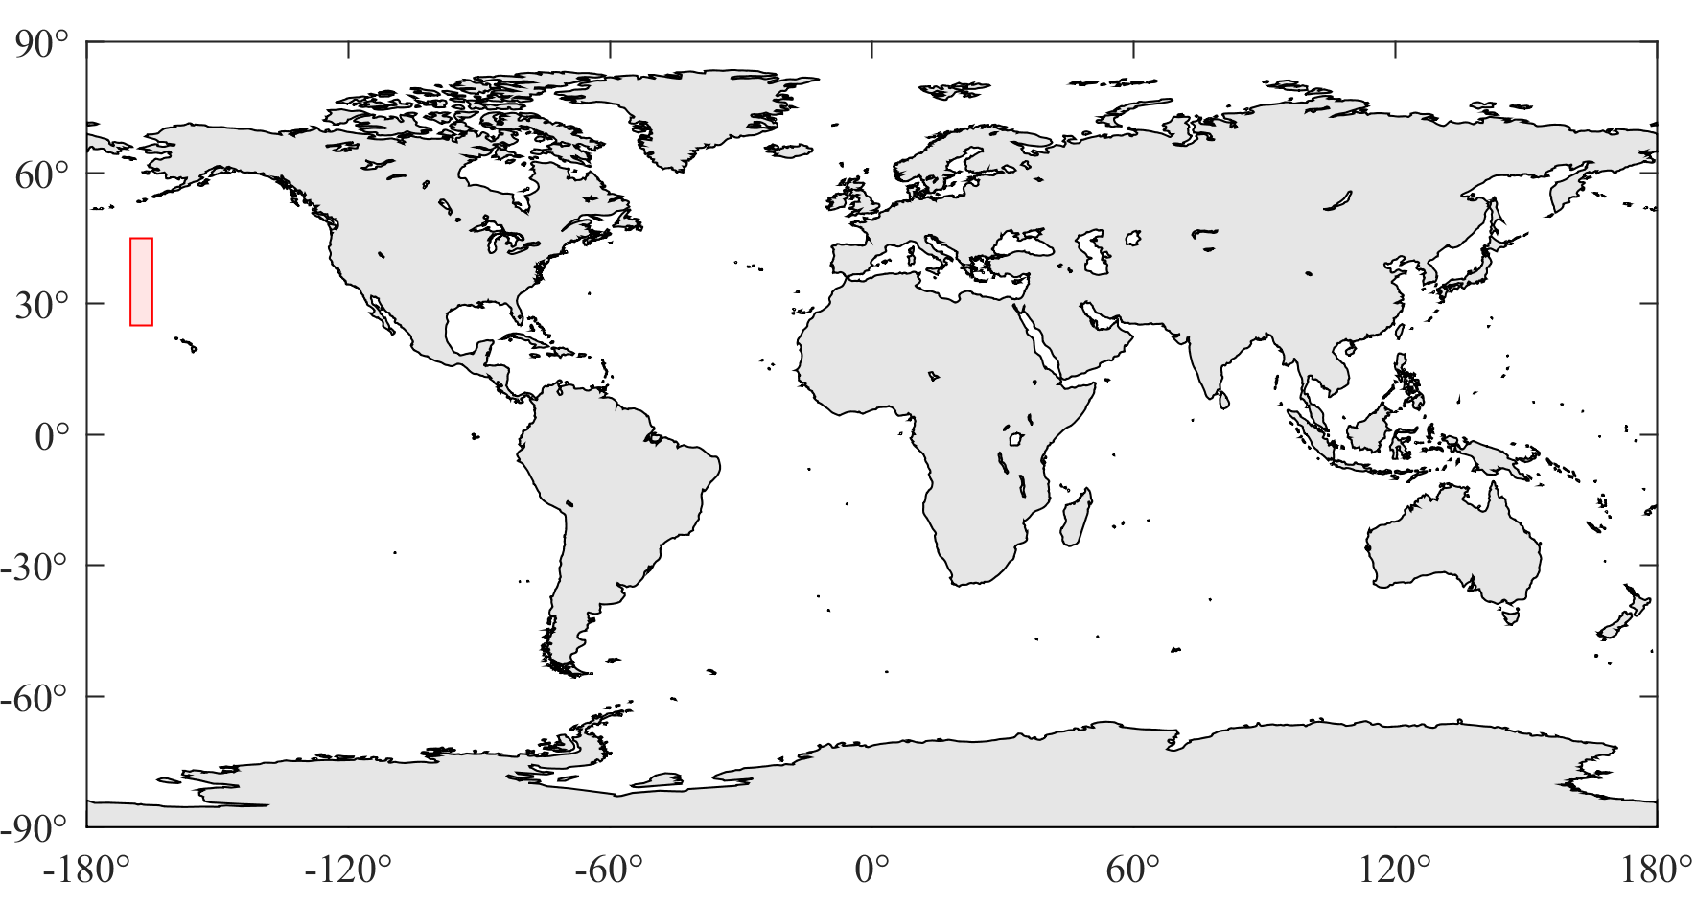
Spectral identification
covariance matrix
reference mean spectrum
$$\tilde{y}={S_{2008}}^{− \frac{1}{2}}(y_{2017}−{\overline{y}}_{2008})$$
whitened spectrum
spectrum
y : octobre 2017
(~20 000 clear-sky IASI spectra)
{$\overline{y,}$ $S$} : 2008
(~120 000 clear-sky IASI spectra)
Detection of 8 halocarbons:
CFC-11, CFC-12, and CCl₄: atmospheric abundance
HCFC-22, HCFC-142b, HFC-134a, CF₄ and SF₆: atmospheric abundance
Other detections: CO₂, HNO₃
➔ A positive (negative) whitened signal indicates a decrease (increase) between 2008 and 2017.

Slide 7
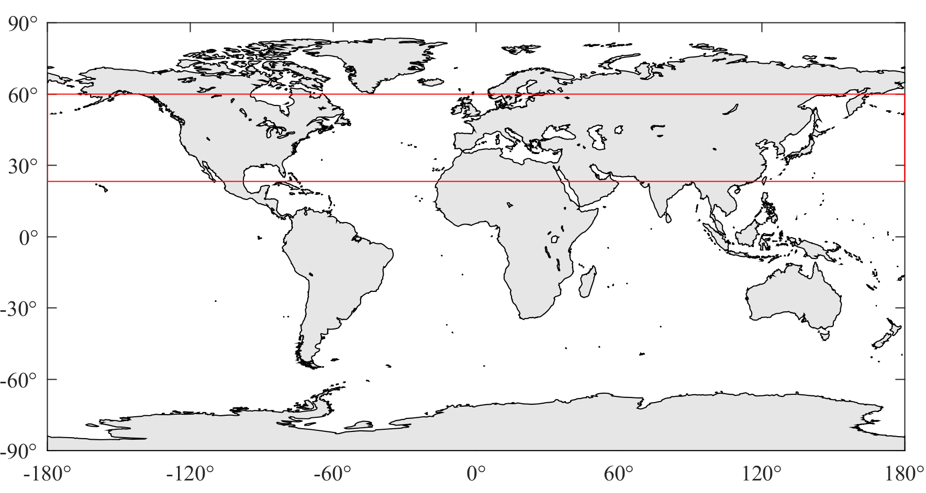
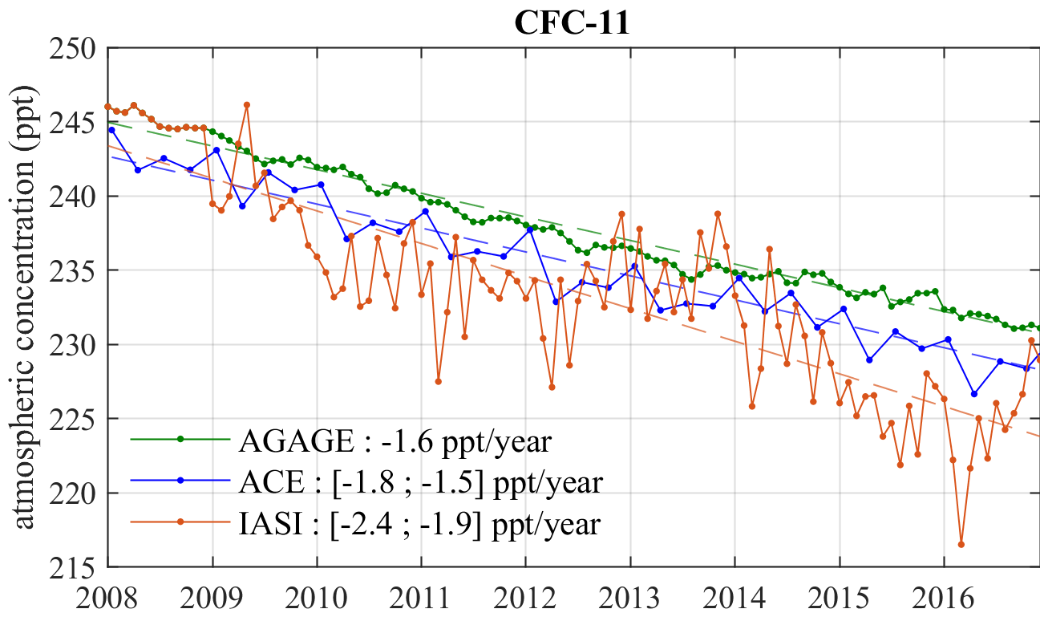
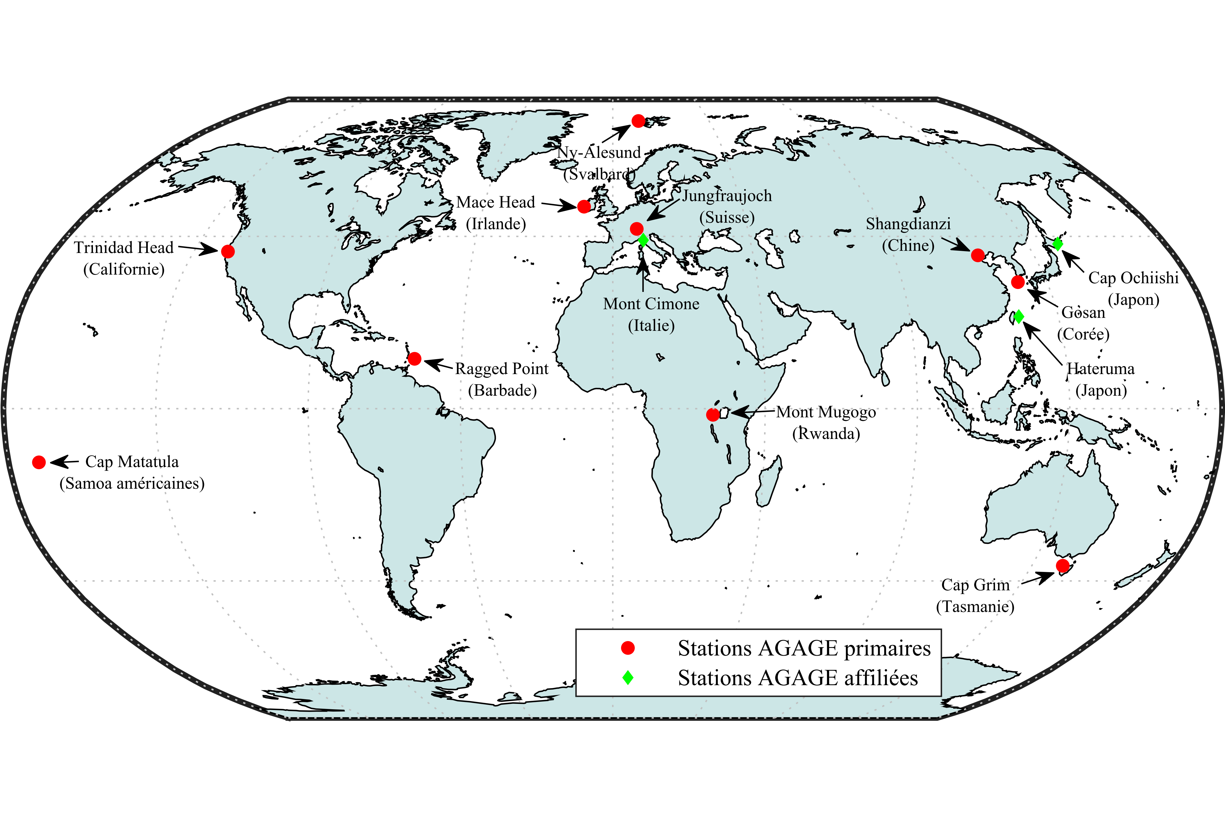
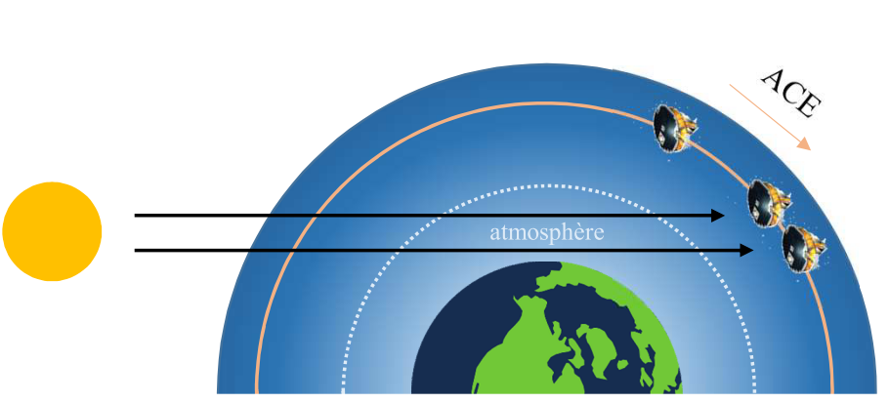
Restitution of atmospheric concentration
Concentration conversion
reference concentration (AGAGE)
reference concentration (AGAGE)
$${\hat{x}}_{m}={x_{0}}_{m}+{\left(K^{T}S_{2008;m}^{−1}K\right)}^{−1}K^{T}S_{2008;m}^{−1}(y_{m}−{\overline{y}}_{2008;m})$$
$$\hat{x}=x_{0}+{\left(K^{T}S^{−1}K\right)}^{−1}K^{T}S^{−1}(y−\overline{y})$$
y : 2008 → 2017 monthly (oceanic region)
(~220 000 clear-sky IASI spectra)
Jacobian
concentration
Jacobian
concentration
{$\overline{y,}$ $S$} : 2008 monthly (oceanic region)
(~220 000 clear-sky IASI spectra)
Walker et al. (2011)
trends → linear regression
comparison with
AGAGE: ground-based in situ measurements
ACE-FTS: limbo satellite sounder

Slide 8
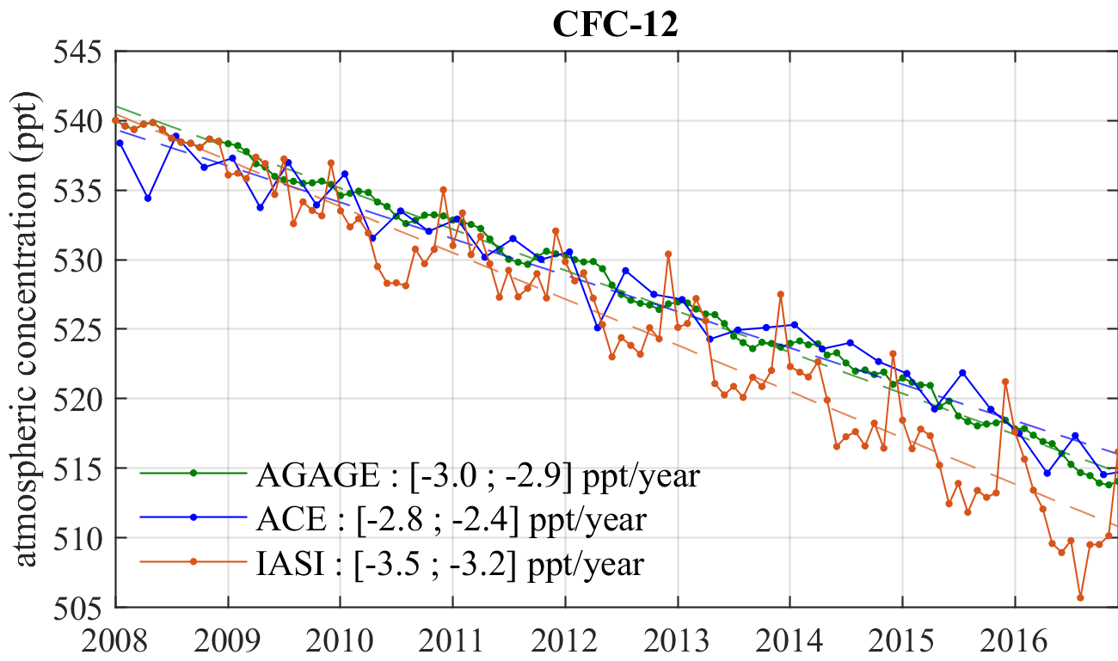
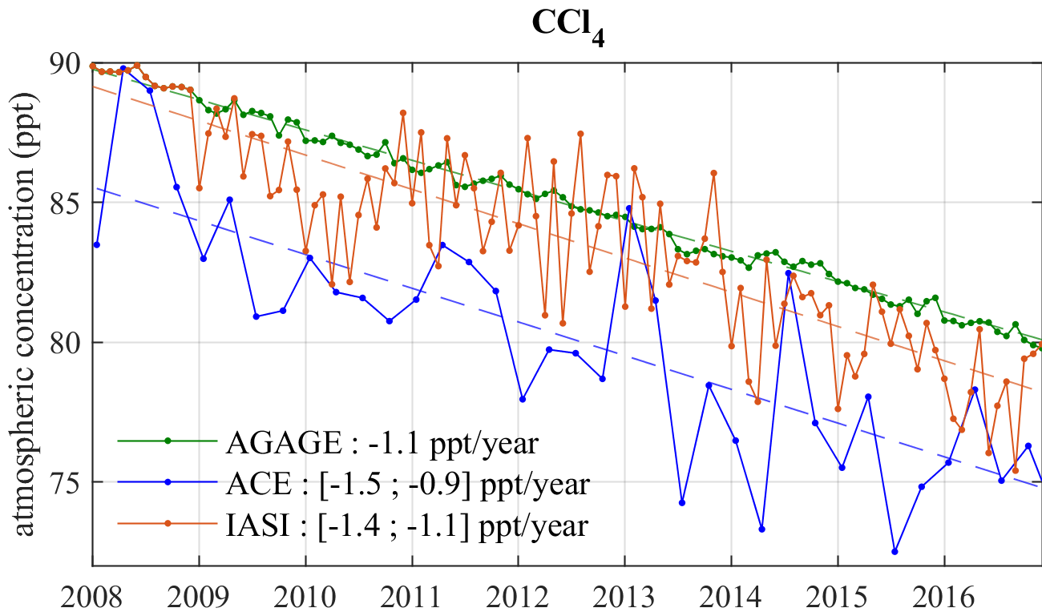
Trends over ten years

Slide 9
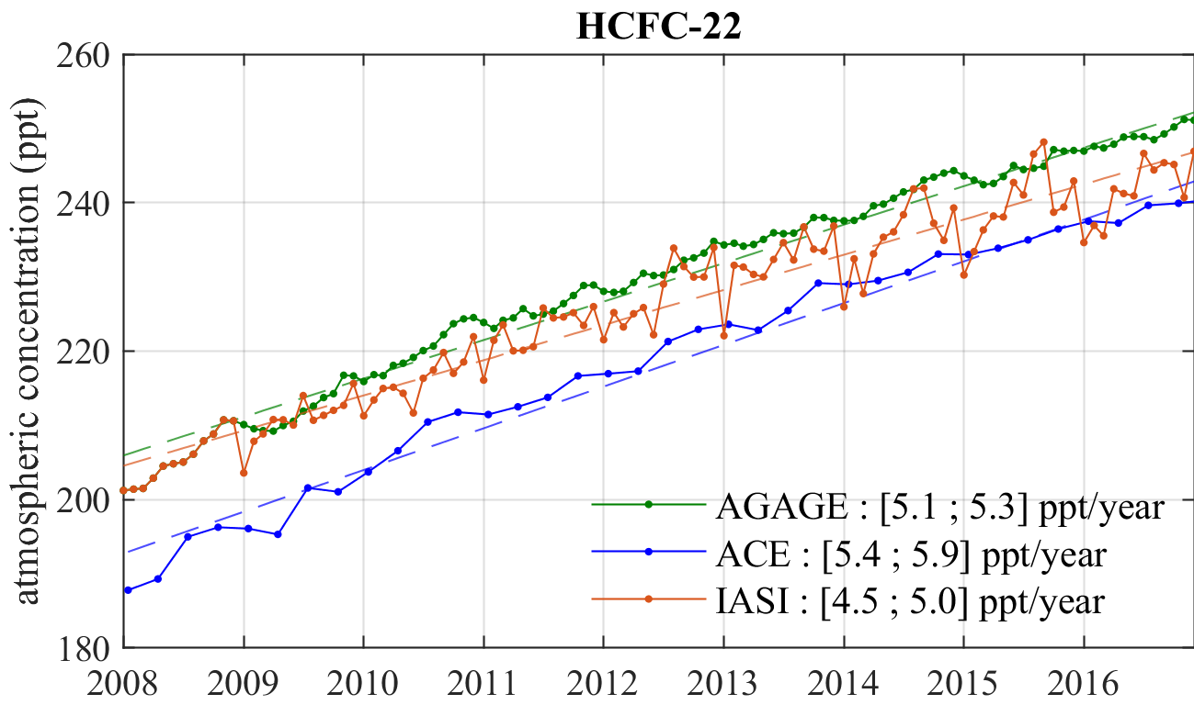
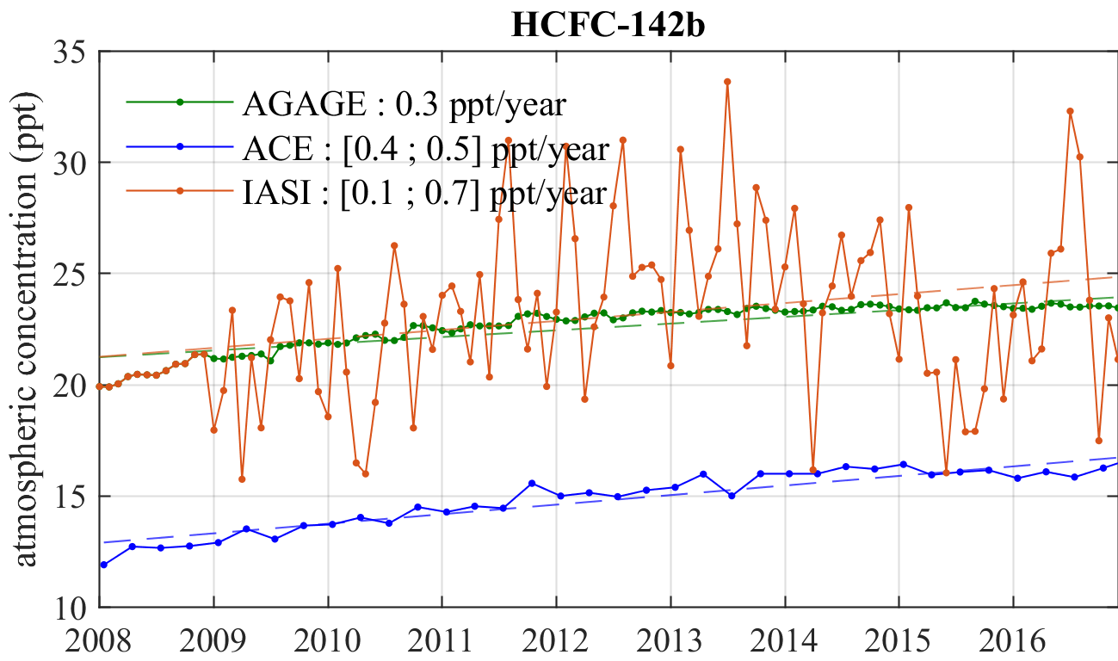
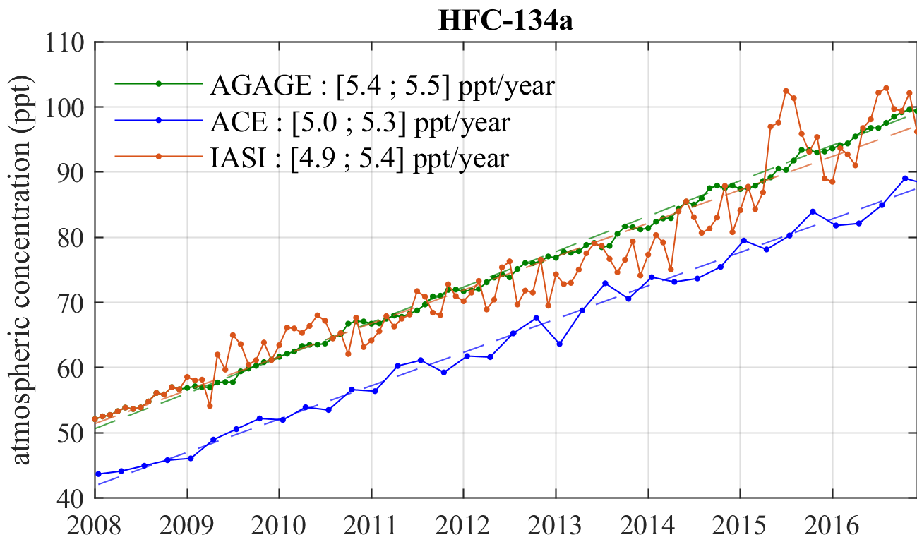
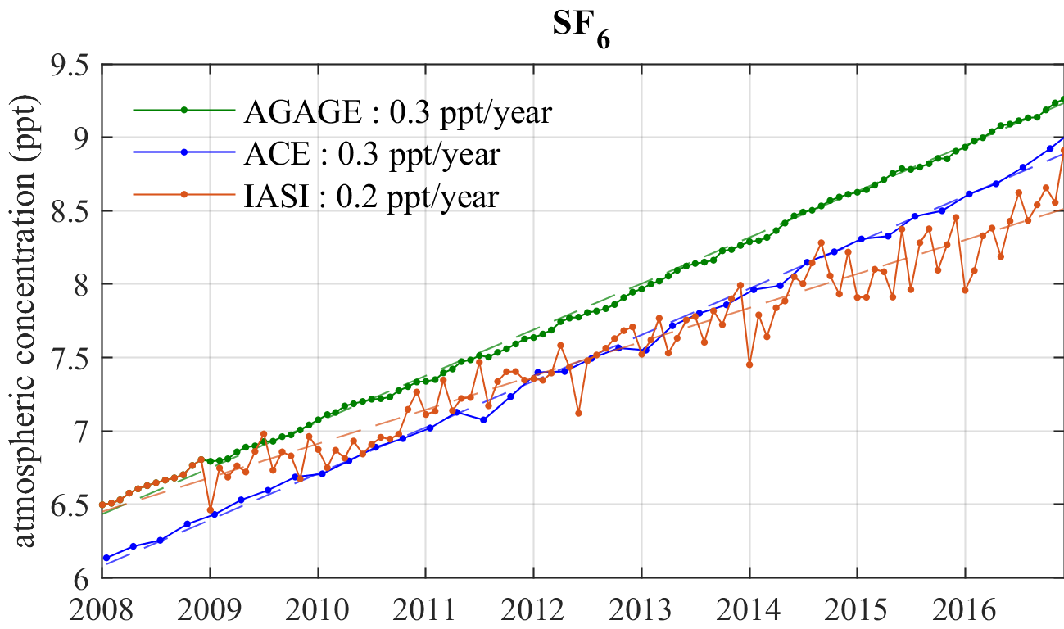
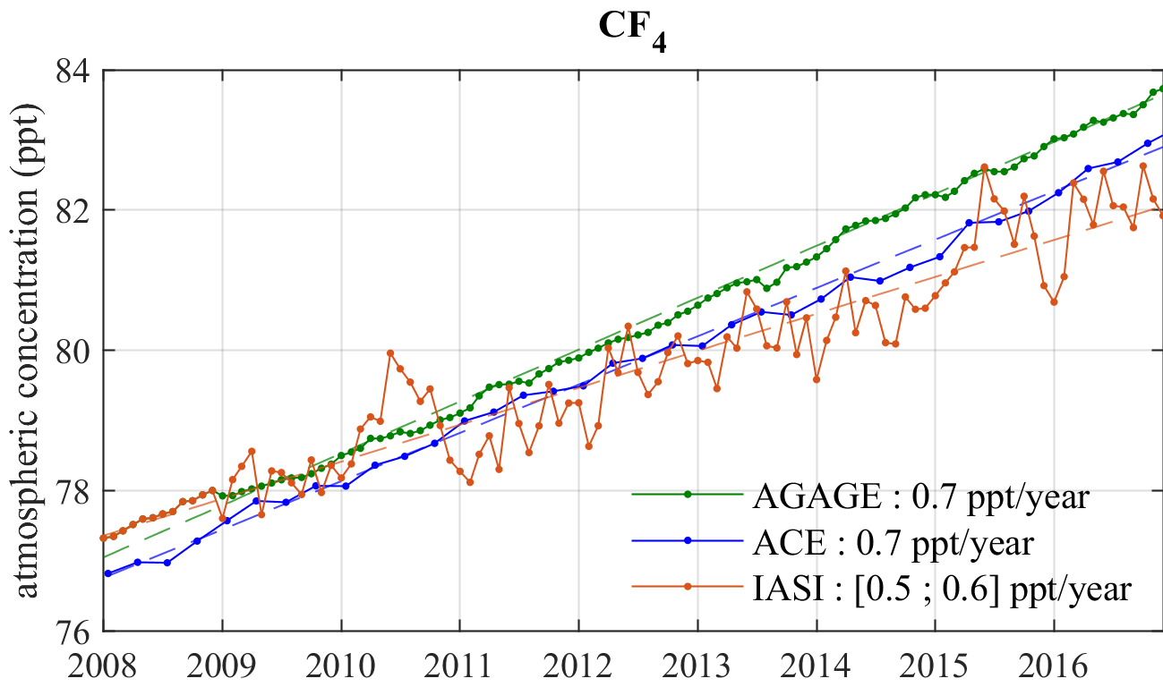
Trends over ten years
→ Interference with HFC-134a ?

Slide 10
Conclusion & Perspectives
Unambiguous detection of eight halocarbons:
CFC-11, CFC-12, HCFC-22, HCFC-142b, HFC-134a, CF₄, SF₆ and CCl₄
Restitution of the temporal evolution of their atmospheric abundance over 10 years
Reasonable agreement with AGAGE and ACE-FTS
Extension to Metop-B and Metop-C
Analyse of the spatial variability
Latitudinal gradient?
Hemispheric gradient?
Hot spots?
Global and long-term monitoring of the atmospheric abundance of halocarbons
Monitoring of the global evolution of the atmosphere system
Verification of the effectiveness of international protocols

Slide 11
References
• World Meteorological Organization, “Scientific Assessment of Ozone Depletion : 2018”, Tech. Rep. 58, Global Ozone Research and Monitoring Project, Geneva, Switzerland, 2018.
• Clerbaux et al., “Monitoring of atmospheric composition using the thermal infrared IASI/MetOp sounder”, Atmospheric Chemistry and Physics, vol. 9, no. 16, pp. 6041-6054, 2009.
• De Longueville et al., “Identification of Short and Long-Lived Atmospheric Trace Gases From IASI Space Observations”, Geophysical Research Letters, 48, 2021.
• Walker et al., “An effective method for the detection of trace species demonstrated using the MetOp Infrared Atmospheric Sounding Interferometer”, Atmospheric Measurement Techniques, vol. 4, no. 8, pp. 1567-1580, 2011.
Helene.De.Longueville@ulb.be

